Slide 1
What the Buddha Really Taught?

Slide 2
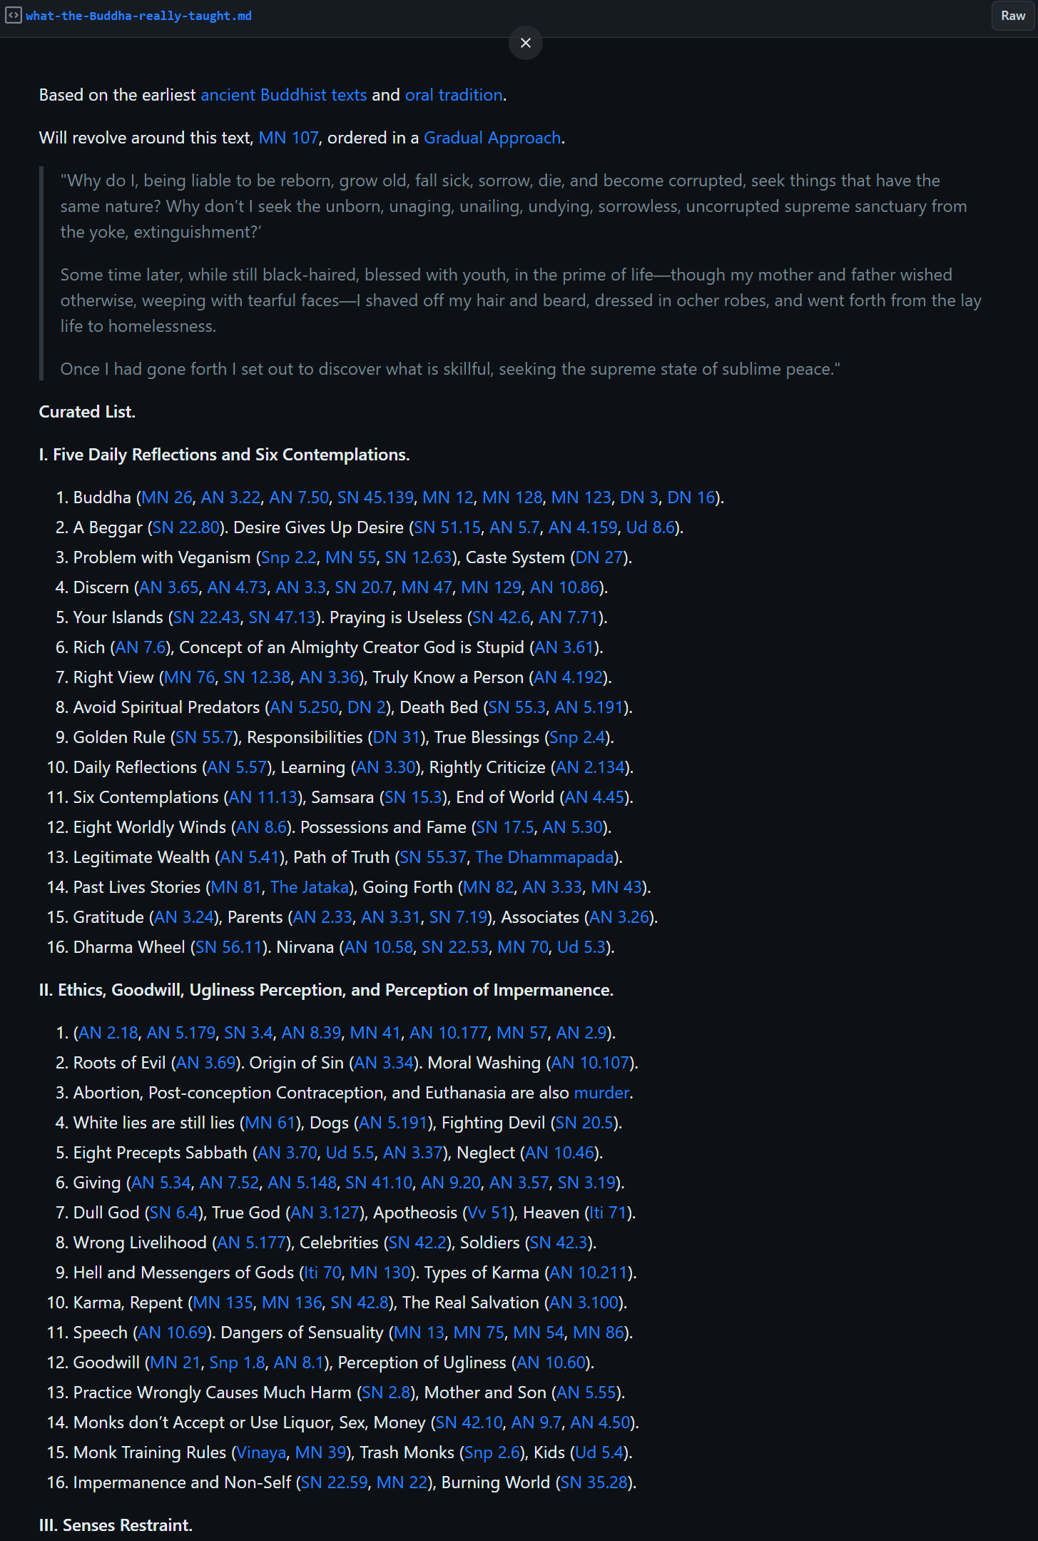
Gist Document

Slide 3
Practical Buddhist Mantras
Five Protections
Five Subjects for Regular Reviewing
Four Descriptions of the World
Four Sublime Emotions
Five Joyful Thoughts
Ugliness Perception
Mindfulness of Breathes
Eight Protections for Sabbath Days

Slide 4
Five Protections
I won’t kill any living beings.
I won’t steal anything.
I won’t engage in sexual misconducts or adultery.
I won’t lie for any reason.
I won’t consume alcohol or mind-altering substances.

Slide 5
Five Subjects for Regular Reviewing
I am liable to grow old, I am not exempt from old age. Intoxicated with the vanity of youth, people do bad things by way of body, speech, and mind.
I am liable to get sick, I am not exempt from sickness. Drunk on the vanity of health, people do bad things by way of body, speech, and mind.
I am liable to die, I am not exempt from death. Drunk on the vanity of life, people do bad things by way of body, speech, and mind.

Slide 6
Five Subjects for Regular Reviewing
I must be parted and separated with all I hold dear and beloved. Aroused by desire and lust for their dear and belove, people do bad things by way of body, speech, and mind.
I am the owner of my actions and heir to my actions. Actions are my womb, my relative, and my refuge. I shall be the heir to whatever deeds I do, whether good or bad. There are sentient beings who do bad things by way of body, speech, and mind.

Slide 7
Four Descriptions of the World
The world is unstable and swept away.
The world has no shelter and no savior.
The world has no owner, you must leave all behind and pass on.
The world is wanting, insatiable, the slave of craving.

Slide 8
Four Sublime Emotions
All living beings seek happiness.
All living beings avoid suffering.
I should delight on their good deeds.
I should focus on my business. What can I possibly do?

Slide 9
Five Joyful Thoughts
I have confidence in the Buddha.
I have confidence in the Dhamma.
I have confidence in the Sangha.
I have good morality that is spotless, blameless, braised by the wise, and lead to samadhi.
I have the qualities of the gods, which are faith, ethics, generosity, learned, and wisdom.

Slide 10
Ugliness Perception
This body, up from the soles of the feet, down from the tips of the hairs, wrapped in skin, contains many kinds of filth:
Head hair, body hair, nails, teeth, skin.
Flesh, sinews, bones, bone marrows, brain.
Kidneys, heart, liver, diaphragm.
Intestines, mesentery, undigested food, feces.
Pile, phlegm, pus, blood, sweat, fat.
Tear, grease, saliva, snot, synovial fluid, urine.

Slide 11
Mindfulness of Breathes
Breathing in heavily they know: ‘I’m breathing in heavily.’ Breathing out heavily they know: ‘I’m breathing out heavily.’
When breathing in lightly they know: ‘I’m breathing in lightly.’ Breathing out lightly they know: ‘I’m breathing out lightly.’
They practice like this: ‘I’ll breathe in experiencing the whole body.’ They practice like this: ‘I’ll breathe out experiencing the whole body.’
They practice like this: ‘I’ll breathe in stilling the physical process.’ They practice like this: ‘I’ll breathe out stilling the physical process.’

Slide 12
Mindfulness of Breathes
They practice like this: ‘I’ll breathe in experiencing rapture.’ They practice like this: ‘I’ll breathe out experiencing rapture.’
They practice like this: ‘I’ll breathe in experiencing bliss.’ They practice like this: ‘I’ll breathe out experiencing bliss.’
They practice like this: ‘I’ll breathe in experiencing mental processes.’ They practice like this: ‘I’ll breathe out experiencing mental processes.’
They practice like this: ‘I’ll breathe in stilling mental processes.’ They practice like this: ‘I’ll breathe out stilling mental processes.’

Slide 13
Mindfulness of Breathes
They practice like this: ‘I’ll breathe in experiencing the mind.’ They practice like this: ‘I’ll breathe out experiencing the mind.’
They practice like this: ‘I’ll breathe in gladdening the mind.’ They practice like this: ‘I’ll breathe out gladdening the mind.’
They practice like this: ‘I’ll breathe in immersing the mind in samādhi.’ They practice like this: ‘I’ll breathe out immersing the mind in samādhi.’
They practice like this: ‘I’ll breathe in freeing the mind.’ They practice like this: ‘I’ll breathe out freeing the mind.’

Slide 14
Mindfulness of Breathes
They practice like this: ‘I’ll breathe in observing impermanence.’ They practice like this: ‘I’ll breathe out observing impermanence.’
They practice like this: ‘I’ll breathe in observing fading away.’ They practice like this: ‘I’ll breathe out observing fading away.’
They practice like this: ‘I’ll breathe in observing cessation.’ They practice like this: ‘I’ll breathe out observing cessation.’
They practice like this: ‘I’ll breathe in observing letting go.’ They practice like this: ‘I’ll breathe out observing letting go.’

Slide 15
Eight Protections for Sabbath Days
I won’t kill any living beings.
I won’t steal anything.
I won’t engage in any sexual activity.
I won’t lie for any reason.
I won’t consume alcohol or mind-altering substances.
I won’t eat more than 1 meal a day or at wrong times.
I won’t touch entertainments or beautify myself.
I won’t sleep on high, comfortable, or luxury beds.

